Slide 1
SABBATH
Does the day truly matter?
Is it an arbitrary loyalty test?

Slide 2
Wealth and Power
If you turn your foot away because of the sabbath, from doing what you please on My holy days, and call the sabbath a delight, to the holiness of Jehovah, glorified; and shall glorify Him, to the holiness of not doing your own ways, from finding your own pleasure or speaking your word; then you shall delight yourself in Jehovah. And I will cause you to ride on the heights of the earth, and make you eat with the inheritance of your father Jacob. For the mouth of Jehovah has spoken. (Isaiah 58:13-14 LITV)

Slide 3
Health
And He said, If you carefully listen to the voice of Jehovah your God, and do what is right in His eyes, and you give ear to His commandments, and keep all His statutes, I will not put on you all the diseases which I have put on Egypt; for I am Jehovah your Healer.
(Exodus 15:26 LITV)

Slide 4
Intelligence
And Jehovah shall make you the head, and not the tail. And you shall be only above, and you shall not be beneath, if you heed the commandments of Jehovah your God, which I am commanding you today, to be careful to do them.
(Deuteronomy 28:13 LITV)

Slide 5
On what points did the Devil particularly tempt the Jews in the Old Testament?
The Fourth and Seventh Commandments
The author of disease and misery will assail men where he can have the greatest success. (PP. 378)

Slide 6
Have SDA’s misunderstood the reason for the Sabbath?

Slide 7
The important point assumed is that the Law is not based in the physical creation itself…. Like a traffic speed limit posted on city roads that are changed at the whim of the city council.
But what if the Law is actually based in the physical creation itself?……..in the way that things were created to work in the first place as suggested in:
Think not that I am come to destroy the law, or the prophets: I am not come to destroy, but to fulfill. For truly I say to you, Till heaven and earth pass, one stroke or one pronunciation mark shall in no wise pass from the law, till all be fulfilled.
(Matthew 5:17-18 AKJV)

Slide 8
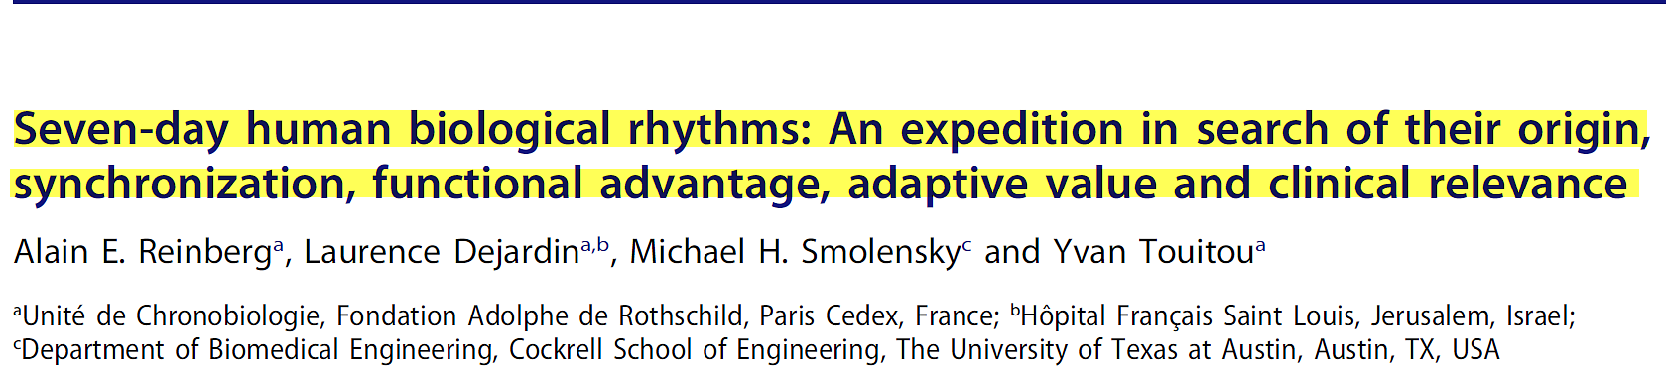
CHRONOBIOLOGY INTERNATIONAL. Nov 2016

Slide 9
We hypothesize the 7 d time structure of human beings is endogenous in origin – a hypothesis that is affirmed by a wide array of evidence – and synchronized by sociocultural factors linked to the Saturday (Hebrews) or Sunday (Christian) holy day of rest. We also hypothesize they are representative, at least in part, of the biological requirement for rest and repair 1 day each 7 d, just as the circadian time structure is representative, in part, of the biological need for rest and repair each 24 h.

Slide 10
These biological rhythms are displayed at various levels of organization in
diverse species – from the unicellular sea algae of Acetabularia and Goniaulax to plants, insects, fish, birds and mammals, including man – under natural as well as artificial (i.e. constant) conditions

Slide 11
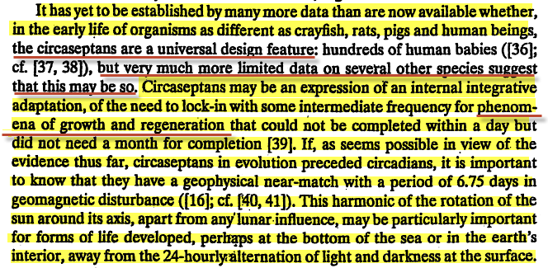

Slide 12
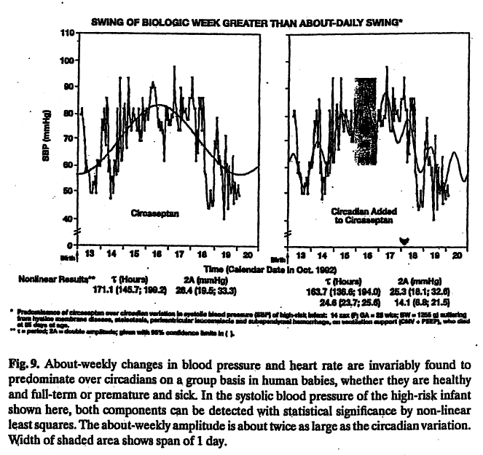

Slide 13
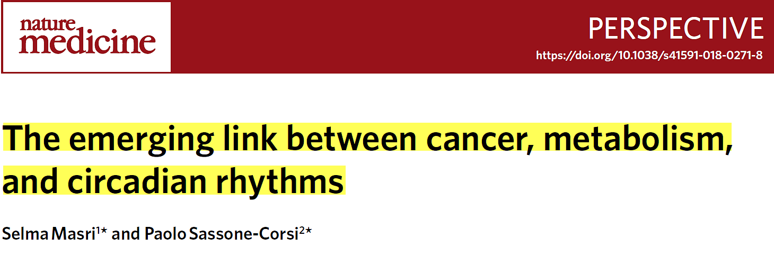
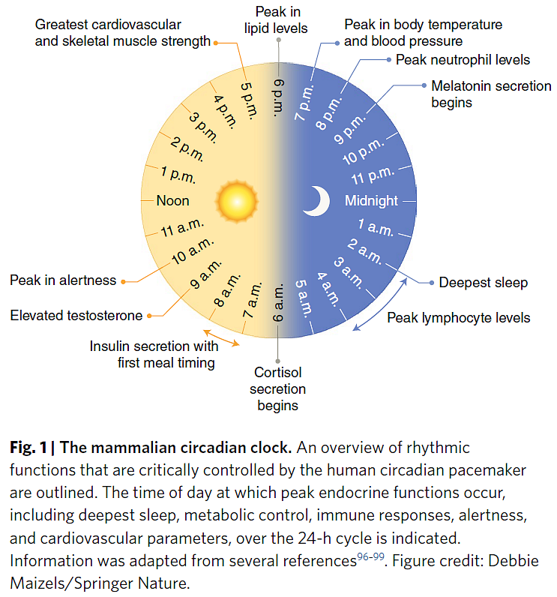
Nature Medicine | VOL 24 | DECEMBER 2018

Slide 14
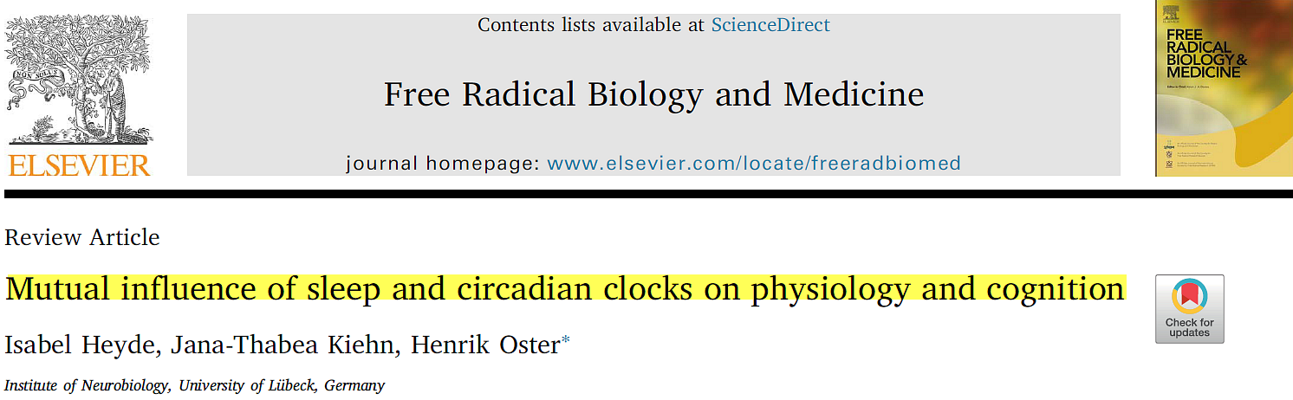
Free Radical Biology and Medicine 119 (2018) 8–16

Slide 15
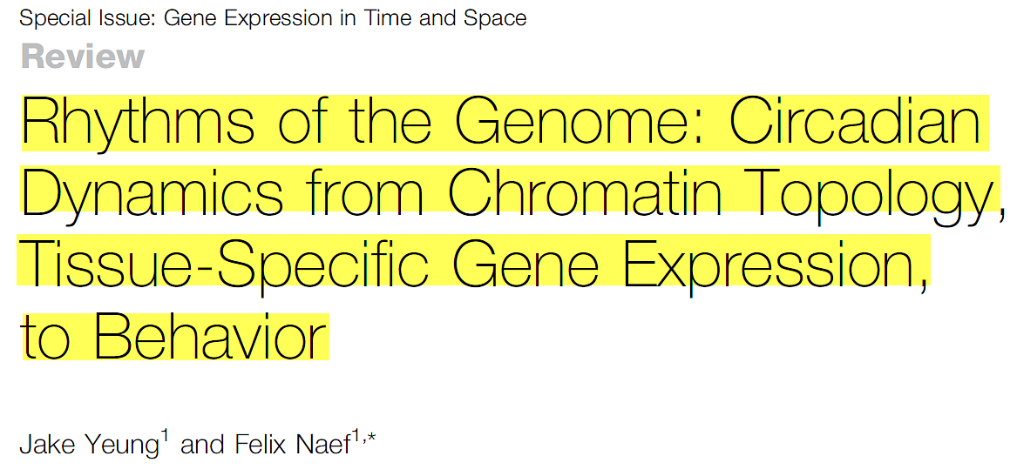
Trends in Genetics, December 2018, Vol. 34, No. 12

Slide 16
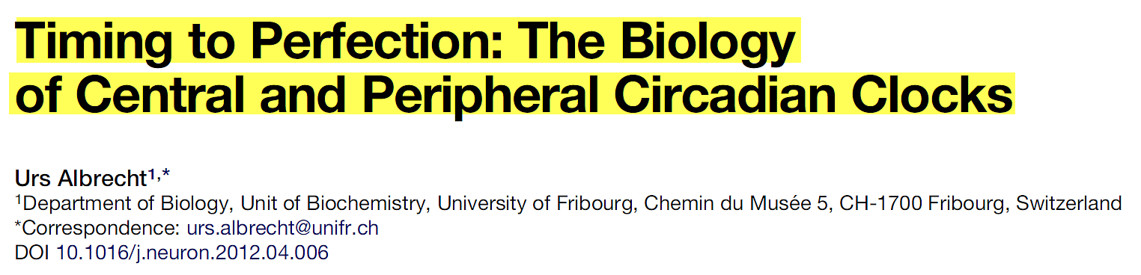
Disturbances in the communication between the plethora of body clocks can desynchronize the circadian system, which is believed to contribute to the development of diseases such as obesity and neuropsychiatric disorders.
Neuron. Vol 74, April 26, 2012

Slide 17
Nature Reviews Neuroscience volume 19 | AUGUST 2018
Driven by cellular ‘clocks’ distributed across the body, these rhythms adjust us to the world by preparing the brain and other tissues to perform very different, often incompatible, functions appropriate to the anticipated day or the anticipated night.

Slide 18
Remember the sabbath day, to keep it holy.
Six days shall you labor, and do all your work:
But the seventh day is the sabbath of the LORD your God: in it you shall not do any work, you, nor your son, nor your daughter, your manservant, nor your maidservant, nor your cattle, nor your stranger that is within your gates:
For in six days the LORD made heaven and earth, the sea, and all that in them is, and rested the seventh day: why the LORD blessed the sabbath day, and hallowed it.
(Exodus 20:8-11 AKJV)

Slide 19
Sign=Seal
Rom 4:11 And he received the sign of circumcision, a seal of the righteousness of the faith which he had yet being uncircumcised: that he might be the father of all them that believe, though they be not circumcised; that righteousness might be imputed unto them also:
Eze 20:12 Moreover also I gave them my sabbaths, to be a sign between me and them, that they might know that I am the LORD that sanctify them.
Eze 20:20 And hallow my sabbaths; and they shall be a sign between me and you, that ye may know that I am the LORD your God.

Slide 20
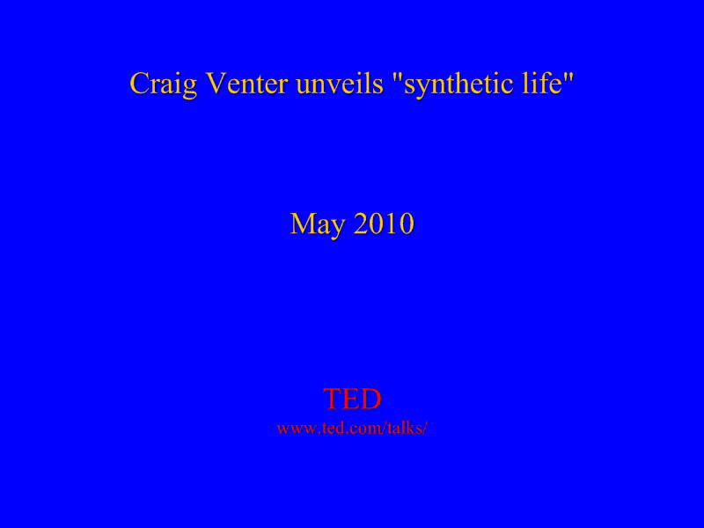

Slide 21
Is it possible the circaseptan rhythm prepares our brains to meet with our Creator?
If you turn your foot away because of the sabbath, from doing what you please on My holy days, and call the sabbath a delight, to the holiness of Jehovah, glorified; and shall glorify Him, to the holiness of not doing your own ways, from finding your own pleasure or speaking your word; (Isa 58:13)then you shall delight yourself in Jehovah. And I will cause you to ride on the heights of the earth, and make you eat with the inheritance of your father Jacob. For the mouth of Jehovah has spoken. (Isa 58:14 LITV)

Slide 22
“For as the rain cometh down, and the snow from heaven, and returneth not thither, till it has moistened the earth, and fertilized it, and made it green, and offered seed to the sower and bread to the eater; so will my word be which goeth forth out of my mouth: it will not return to me fruitless, till it has accomplished that which I willed, and prosperously carried out that for which I sent it.” (Isa 55:10,11 K&D)

Slide 23
What will be the final test during the Time of Trouble?
The time of trouble is soon to break upon us, and the decree will go forth that everyone who will not keep the first day of the week shall be put to death. Those who have not regarded the Sabbath as they should, who have exalted their business above God's commandment, will trample upon the Sabbath and keep the first day of the week, because they have consulted their own convenience before the honor of God. They did not learn to bring themselves into harmony with the Sabbath, but sought to bring the Sabbath to meet their own convenience. With the preparation they have made, they are no more fitted to stand in the day of judgment than the greatest sinner. (ST June2, 1890)

Slide 24
Latter Rain

Slide 25
For as the new heavens and the new earth, which I will make, shall remain before me, saith the LORD, so shall your seed and your name remain. And it shall come to pass, that from one new moon to another, and from one sabbath to another, shall all flesh come to worship before me, saith the LORD. (Isa 66:22-23 KJV)

